Slide 1
بِسْمِ ٱللَّهِ ٱلرَّحْمَٰنِ ٱلرَّحِيمِ

Slide 2
Course: Web Designing
Institute: Corvit Systems Peshawar
Duration: 3-Month Web Designing & Development Course
2nd class of JS (Java script)
Topic : Conditions and operators

Slide 3
Instructor: Muhammad Sahil
BS in Computer Science – University of Peshawar
1 Year MERN Stack Developer – E Digital Pakistan (KPITB)
1 Year Web Instructor – E Digital Pakistan
6 Months Web Instructor – University of Peshawar
Computer Science Teacher – Alflah Model College, Sarband
Experience with multiple local client projects
Full Stack / MERN Stack Web Developer | Web Instructor

Slide 4
What are Operators in JavaScript?
Operators are symbols used to perform operations on values and variables.
JavaScript operators help in:
Calculations
Comparisons
Decision making
Main types we study today:
Arithmetic Operators
Comparison Operators
Logical Operators

Slide 5
Arithmetic Operators
Used for mathematical calculations.
Common arithmetic operators:
( + ) Addition
( - ) Subtraction
( * ) Multiplication
( / ) Division
( % ) Modulus (remainder)
Used in calculators, marks calculation, totals, etc.

Slide 6
Comparison operators
return true or false.
Used to compare values.
Examples:
== Equal value
=== Equal value & type
!= Not equal
> Greater than
< Less than
>= Greater than or equal
<= Less than or equal
Used in conditions and decisions.

Slide 7
Logical Operators
Logical operators are used to combine conditions.
Types:
&& AND → All conditions must be true
|| OR → Any one condition true
! NOT → Reverse the result
Used in login systems and validations.

Slide 8
IF STATEMENT
The if statement executes code only when the condition is true.
Example use cases:
Pass / Fail
Age check
Eligibility check
If condition is false, code does not run.

Slide 9
IF ELSE & ELSE IF STATEMENTS
if else:
Two possible outcomes
else if:
Multiple conditions
Used for grading systems
Used in marks, scores, ranges
Helps in decision making.

Slide 10
Code example Screen shots from next slide

Slide 11
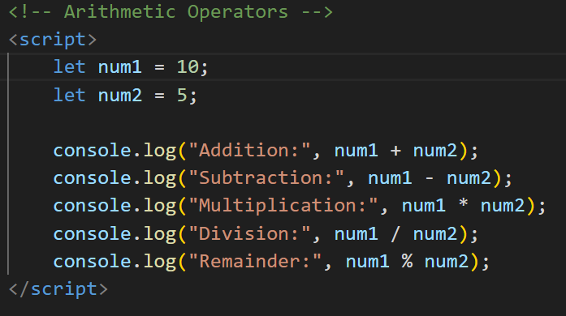
Arithmetic Operators

Slide 12
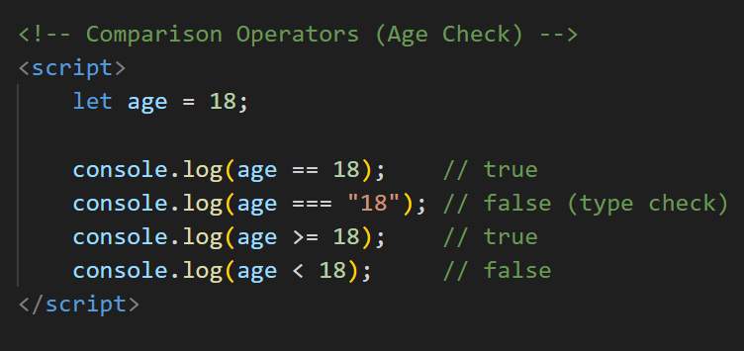
Comparison Operators

Slide 13
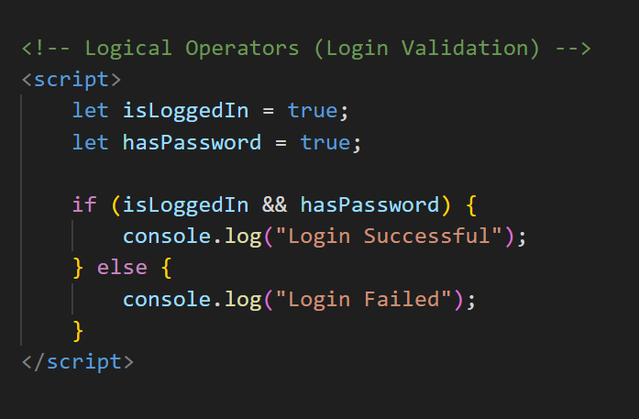
Logical Operators

Slide 14
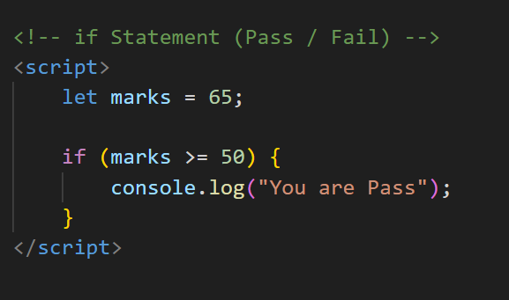
If Statement

Slide 15
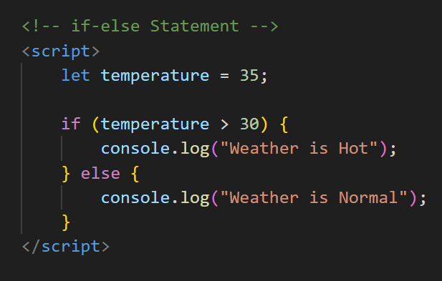
If – else Statement

Slide 16
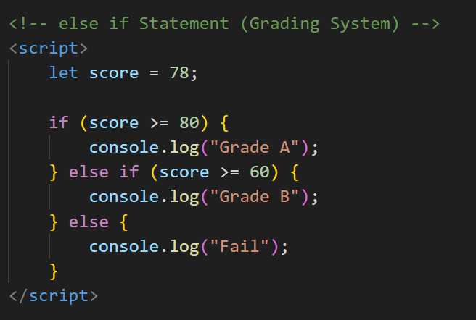
Else if Statement

Slide 17
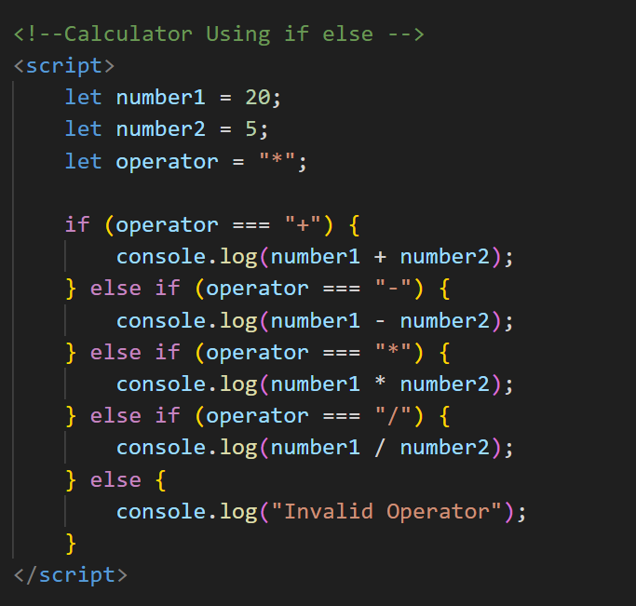
Calculator

Slide 18
Practice & Summary
Practice Example:
Basic calculator logic
Uses of operators + conditions
Today you learned:
Arithmetic operators
Comparison operators
Logical operators
if, else, else if

